Slide 1
PROJECT TITLe secure data hiding in image using steganography
CAPSTONE PROJECT
Presented By: Ajay Vilas Rathod
Student Name : Ajay Vilas Rathod
College Name & Department : Government college of engineering Karad - electronics and telecommunications

Slide 2
OUTLINE
Problem Statement
Technology used
Wow factor
End users
Result
Conclusion
Git-hub Link
Future scope

Slide 3
Problem Statement
In the digital age, the secure exchange of information isincreasingly vital, prompting the need for advanced techniques thatguarantee confidentiality. Conventional communication methodsoften fall short in providing robust data security. This projectaddresses the pressing challenge of secure information exchangeby formulating a steganographic application. The problem lies inthe inadequacy of existing communication channels to safeguardsensitive data effectively. Consequently, there is a crucial need foran intuitive and secure solution that seamlessly integratessteganography into everyday communication, ensuring the coverttransmission of confidential text messages within images
.

Slide 4
Technology used
cv2 library, OS library, string

Slide 5
Wow factors
This project is a unique project from the others project. In this we can hide a secret message in simple image and send it securely to the others.

Slide 6
End users
Who are the end users –end users like army level, IT sectors, MNCs, etc

Slide 7
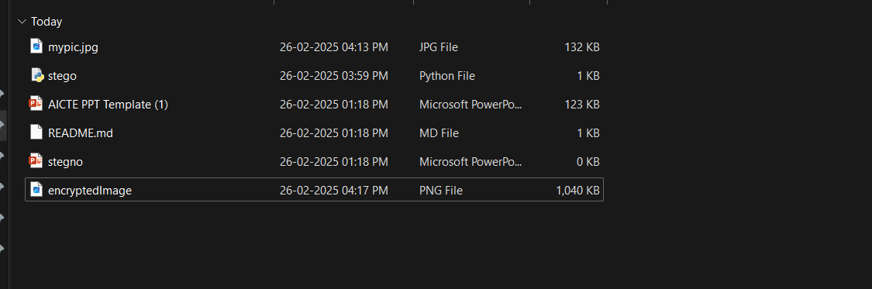
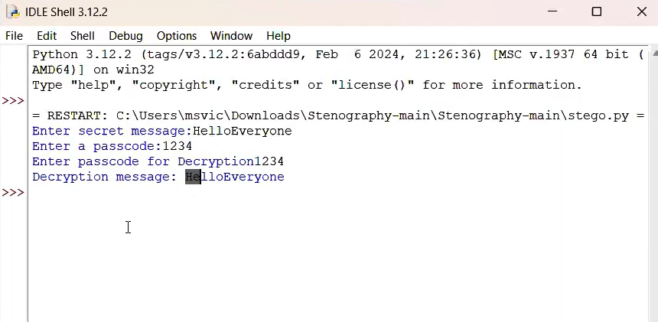

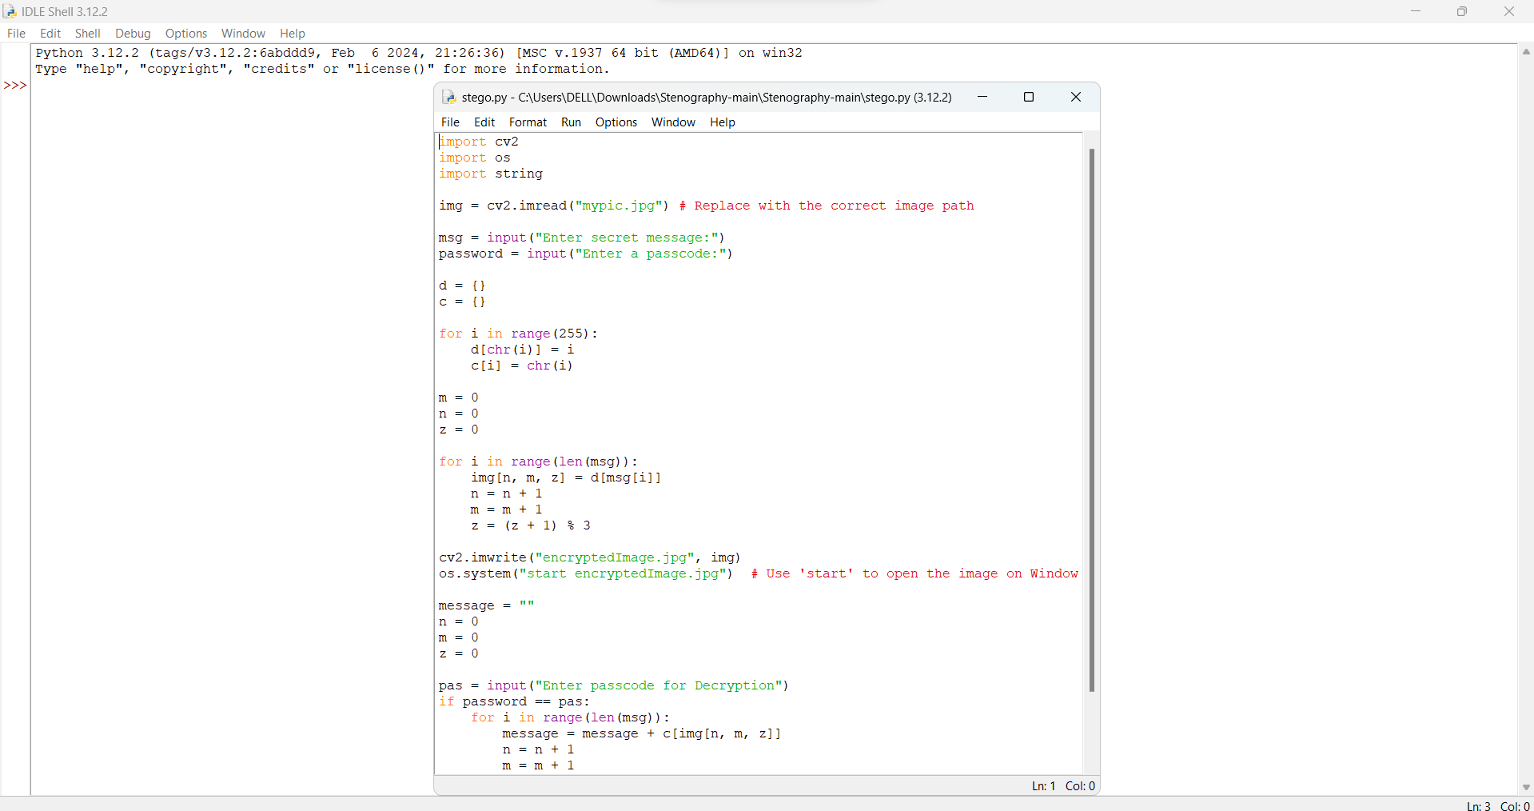


Results
Original image Decrypted image

Slide 8
Conclusion
This project is most secure project to send the data to the another without knowing to the other or hacker. We use a normal image to send the data using steganography method.

Slide 9
GitHub Link
https://github.com/Ajayrathod0703/ajay-code.git

Slide 10
Future scope(optional)

Slide 11
THANK YOU

